Slide 1
SAE 15 GOTTI Florent

Slide 2
01
Instructions for use
Sort file

Slide 3
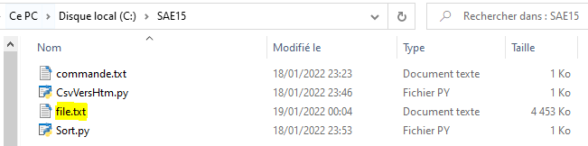

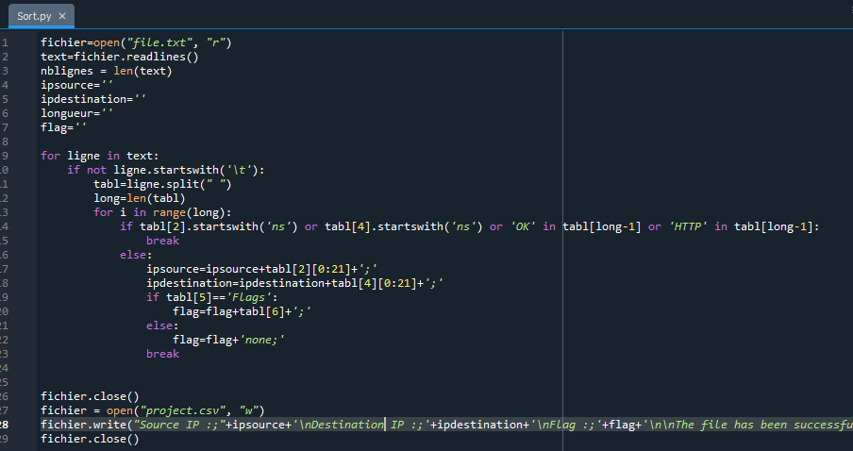

First, rename the file you want to process “file.txt” and put it in “SAE15”
Then, you can right click on and open it with Spyder
If you do it correctly, you will be able to see this window in Spyder :
Now, you just have to press f5
to start the sort

Slide 4
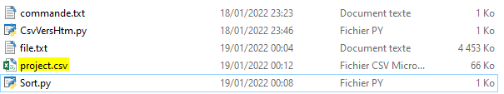
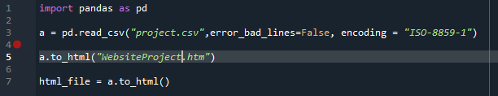
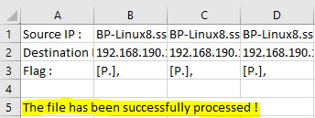
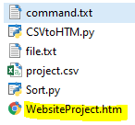
A CSV file appeared !
Now, if you want to show it on a website, you just have to open this with Spyder :
Then, you can open it
And see if it worked
Then, press F5
It just created your Website !
(If you see the message
in the line number 5,
everything worked properly)

Slide 5
Open it and enjoy !
(If it doesn’t work, use the command in the
terminal which is in the text file “command.txt” )

